Slide 1

NIKHIL(1602-19-733-082)
PAVAN(1602-19-733-086)

Slide 2
Modules used
Tkinter – It is the standard GUI library for Python.
OS - The OS module in Python provides functions for interacting with the operating system.
datetime - Datetime module supplies classes to work with date and time

Slide 3
CONTENTS
-OBJECTIVE
-WORKING
-FEATUERES
-DEMONSTRATION

Slide 4
OBJECTIVE
ALLOW THE USER TO MAKE TRANSACTIONS,DEPOSIT AND WITHDRAW FUNDS,AND CHECK THE ACCOUNT BALANCE THEREBY IMPROVING CUSTOMER EXPERIENCE BY REMOVING HASSLES AND ENCHANCING THE FACILIATES.

Slide 5
WORKING
IN THIS WE HAVE AN ADMIN SECTION WHICH LOOKS AFTER THE USER’S ACCOUNTS AND A STORE ALL THE USER’S INFORMATION IN A FILE AND A USER SECTION WHERE WE CAN MAKE TRANSACTIONS.

Slide 6
features
-IT ALLOWS THE USERS TO OPEN THEIR ACCOUNTS
-USERS CAN MAKE TRANSACTIONS BY ENTERING RESPECTIVE AMOUNTS
-USERS CAN CHECK THE BALANCE OF THEIR ACCOUNTS
-ADMIN CAN VIEW A LIST OF USERS TO SEE HOW MANY USERS THERE ARE ALONG WITH THEIR DETAILS,CREATE ACCOUNTS,CLOSE ACCOUNTS

Slide 7
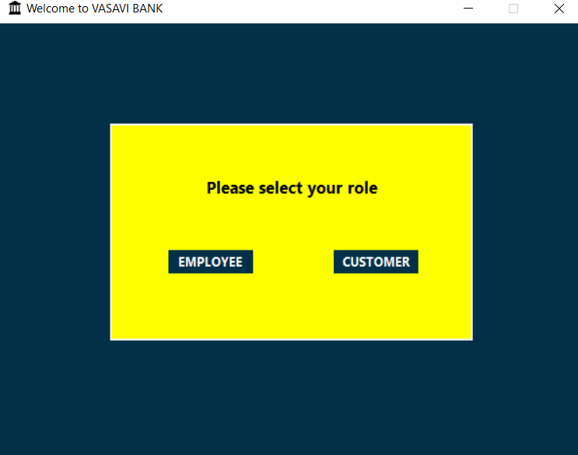
User interface
WE HAVE TWO OPTIONS,ADMIN CAN LOGIN THROUGH ADMIN CREDENTIALS AND CUSTOMER CAN LOGIN THROUGH CUSTOMER CREDENTIALS

Slide 8
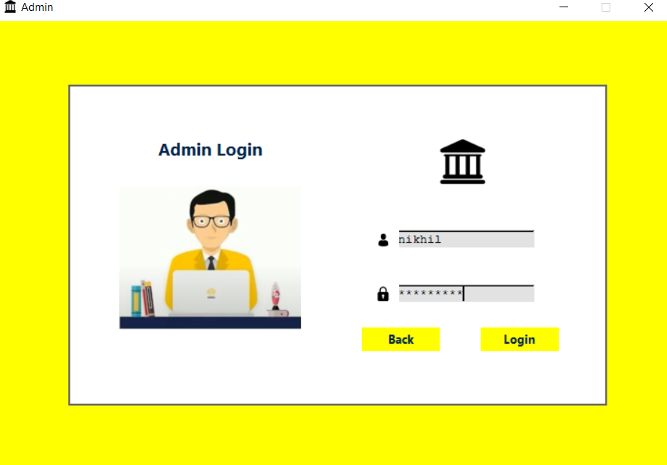
ADMIN INTERFACE

Slide 9
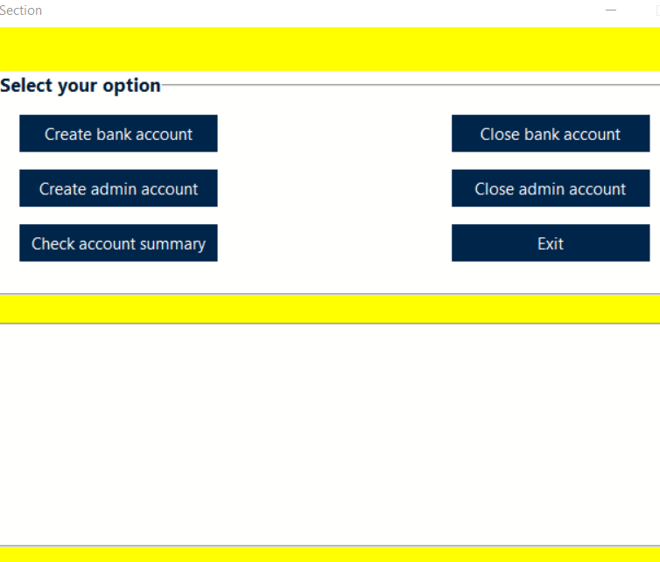
ADMIN SECTION
IN THIS SECTION,WE CAN EITHER CREATE A NEW BANK ACCOUNT,ADMIN ACCOUNT,CHECK THE ACCOUNT BALANCE OF THE ACCOUNT HLODERS AND CLOSE ANY ACCOUNT.

Slide 10
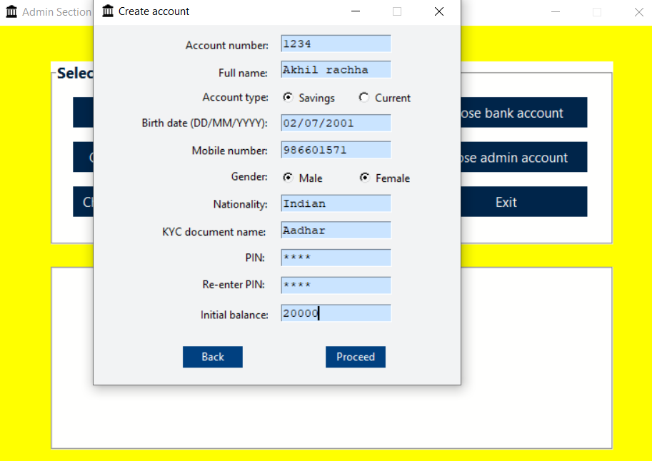
CREATE AN ACCOUNT
.

Slide 11
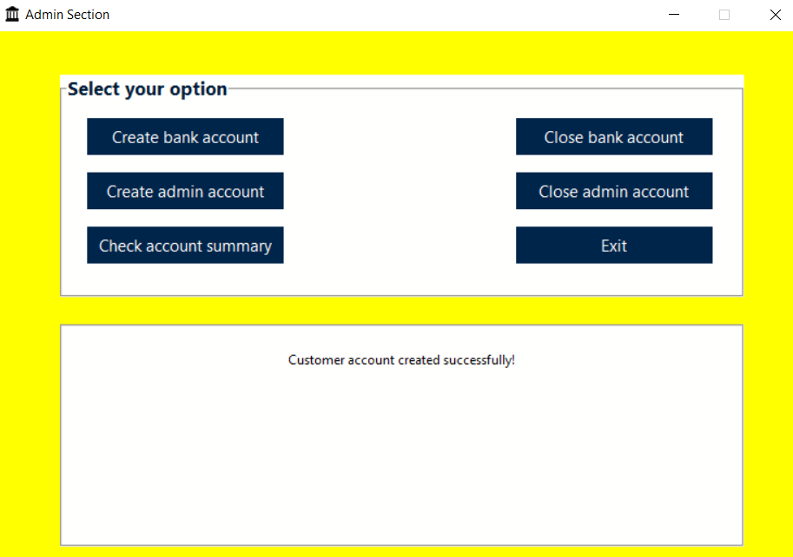

Slide 12
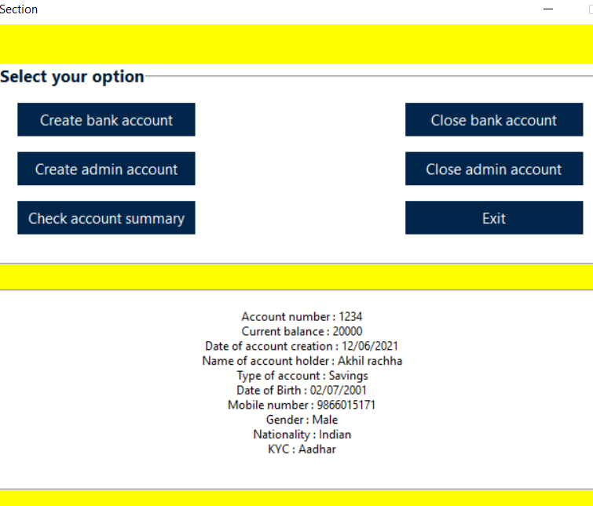
CHECK ACCOUNT SUMMARY
ALL THE DETAILS OF THE ACCOUNT HOLDER ARE DISPLAYED BY ENTERING THEIR RESPECTIVE ACCOUNT NUMBER

Slide 13

CLOSE BANK ACCOUNT
WE CAN CLOSE BOTH ADMIN AND CUSTOMER ACCOUNTS BY ENTERING THEIR ACCOUNT NUMBER .

Slide 14
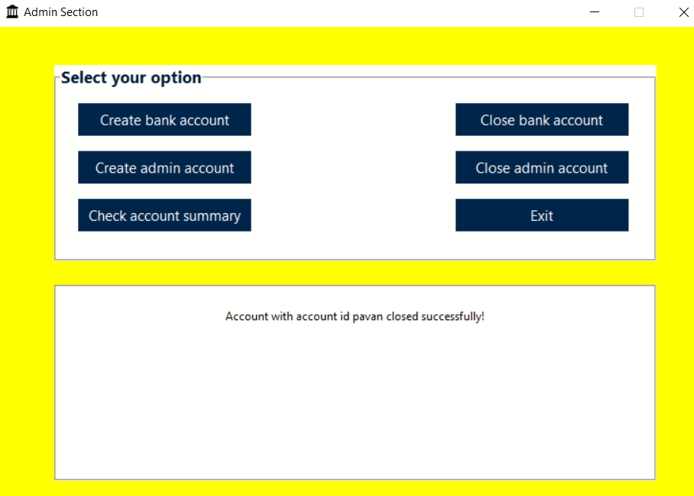

Slide 15
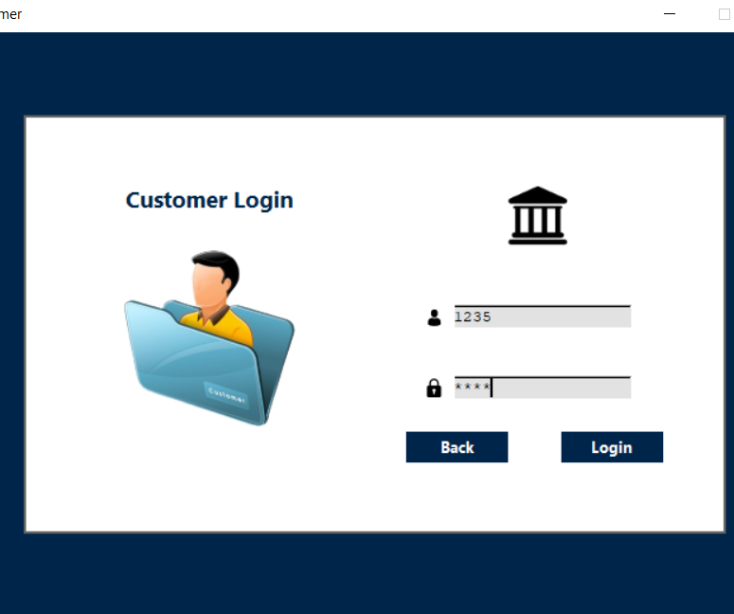
CUSTOMER INTERFACE

Slide 16
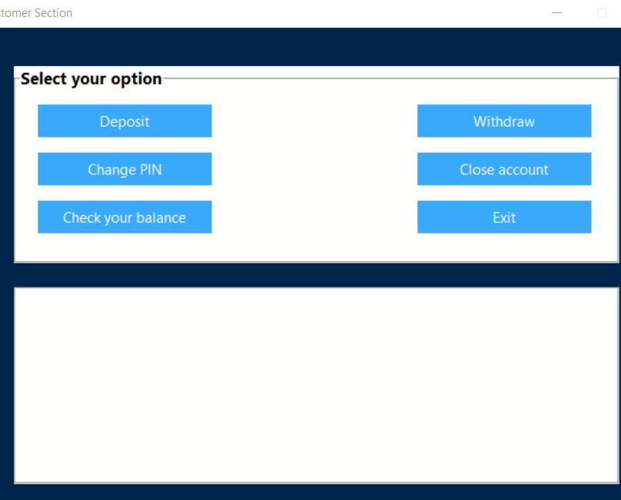
CUSTOMER SECTION
HERE THE ACCOUNT HOLDERS CAN EITHER DEPOSIT,WITHDRAW,CHECK BALANCE,CHANGE PIN AND CLOSE THEIR BANK ACCOUNTS

Slide 17
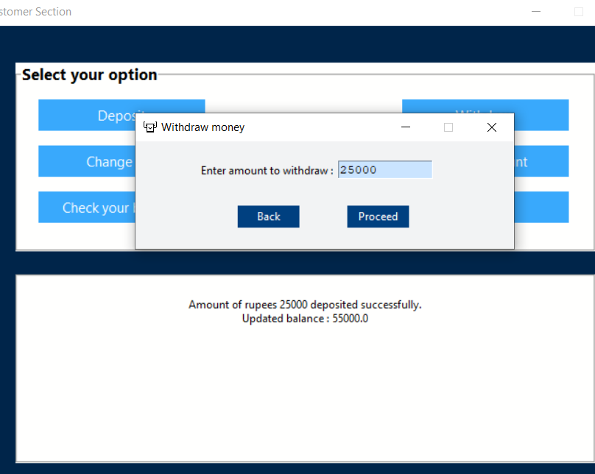
WITHDRAW MONEY

Slide 18
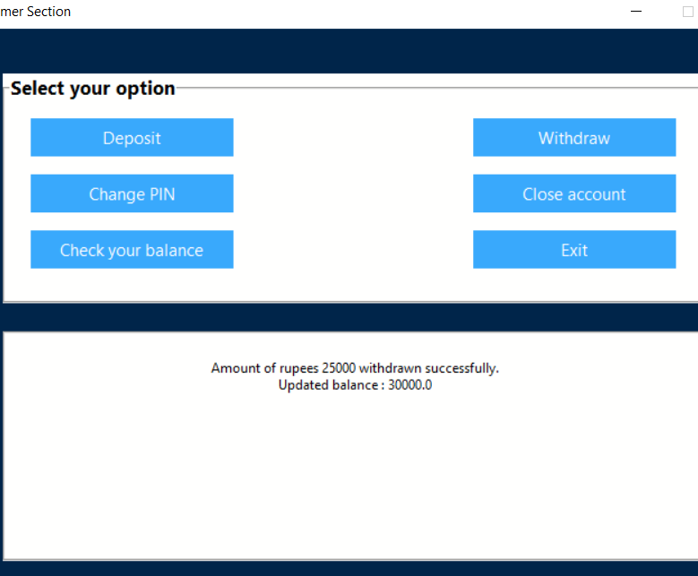

Slide 19
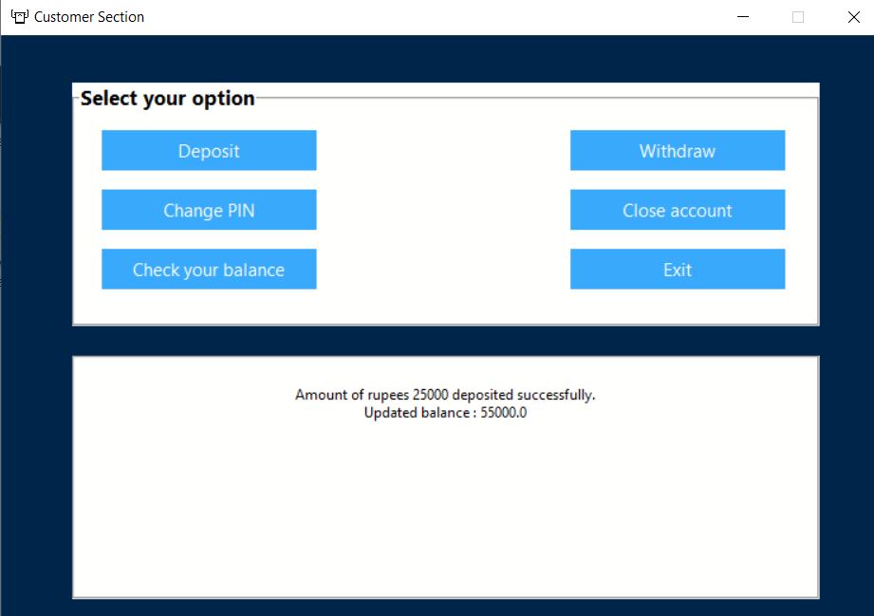
DEPOSIT MONEY

Slide 20
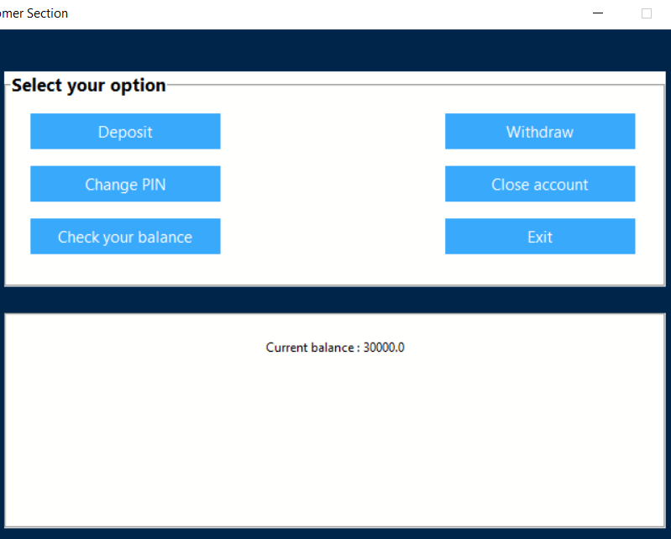
CHECK BALANCE

Slide 21
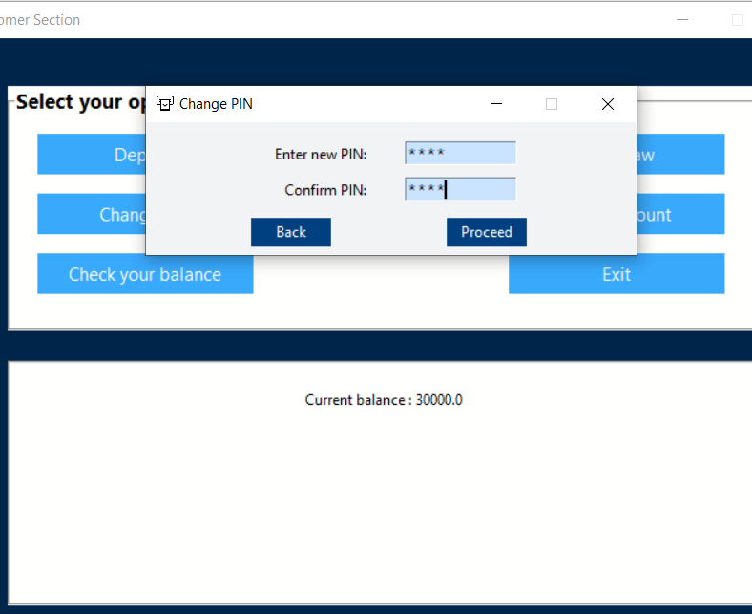
CHANGE PIN

Slide 22
CONCLUSION
-THE BANK MANAGEMENT SYSTEM PROJECT IN PYTHON IS A EASY CONSOLE BASED MACHINE THAT’S VERY CLEAN TO APPREHEND AND USE,IT CONTAINS ALL OF THE BASIC FUNCTIONS WHICH CONSIST OF CREATING A NEW ACCOUNT,VIEW CLIENT RECORDS ,WITHDRAW AND DEPOSIT MONEY.
-PYTHON WHEN COMBINED WITH TKINTER PROVIDES A FAST AND EASY WAY TO CREATE GUI APLLICATIONS MAKING IT USER FRIENDLY.

Slide 23
DEMONSTRATION

